Slide 1
Database API Viewed As A Mathematical Function: Insights into Testing
Brendan Furey, March 2018
A Programmer Writes… (Brendan's Blog)
Ireland Oracle User Group, March 22-23, 2018
Notes:
http://aprogrammerwrites.eu/

Slide 2
whoami
Freelance Oracle developer and blogger
Dublin-based Europhile
25 years Oracle experience, currently working in Finance
Started as a Fortran programmer at British Gas
Numerical analysis and optimization

Slide 3
Agenda
A Design Pattern for Testing Database APIs (12 slides)
Developing a universal design pattern for testing APIs using the concept of a ‘pure’ function as a wrapper to manage the ‘impurity’ inherent in database APIs
A General Data Model for Testing (4 slides)
Explaining why a general model is appropriate, and detailing the model in logical terms and with physical array structures
GDM Output and Code Examples (4 slides)
Showing how test inputs and outputs can be displayed using the data model, giving some PL/SQL code examples, and some notes on frameworks
Test Coverage by Domain Partitioning (8 slides)
Explaining why code coverage is not a useful testing metric and developing, from examples, the concept of domain partitioning as a better approach for test analysis
Testing Strategies (7 slides)
Discussing testing strategies, including the limits of testing, why/when/what to automate, and the homeopathic unit testing antipattern
Conclusion (2 slides)
Highlighting the value gained from viewing database APIs and other code from the perspective of the mathematical function for both functional and performance testing

Slide 4
A Design Pattern for Testing Database APIs
A Design Pattern for Testing Database APIs
Developing a universal design pattern for testing APIs using the concept of a ‘pure’ function as a wrapper to manage the ‘impurity’ inherent in database APIs

Slide 5
Testing Context – Thick Database Paradigm
Guarding your data behind a hard shell PL/SQL API, OOW 2017
Why use PL/SQL?, 2015
Manual testing
API is called for multiple scenarios
Calls may or may not be scripted
Developer checks results using ad hoc queries
Automated testing
PL/SQL program loops over scenarios
Checks results of API calls
Input setup included in program
“A huge benefit of the Thick Database paradigm is that both the functional correctness and the performance of the database module can be tested independently of any outside-of-the-database code that will use it.” – Bryn Llewellyn
Notes:
https://community.oracle.com/docs/DOC-1018915
https://blogs.oracle.com/plsql-and-ebr/why-use-plsql

Slide 6
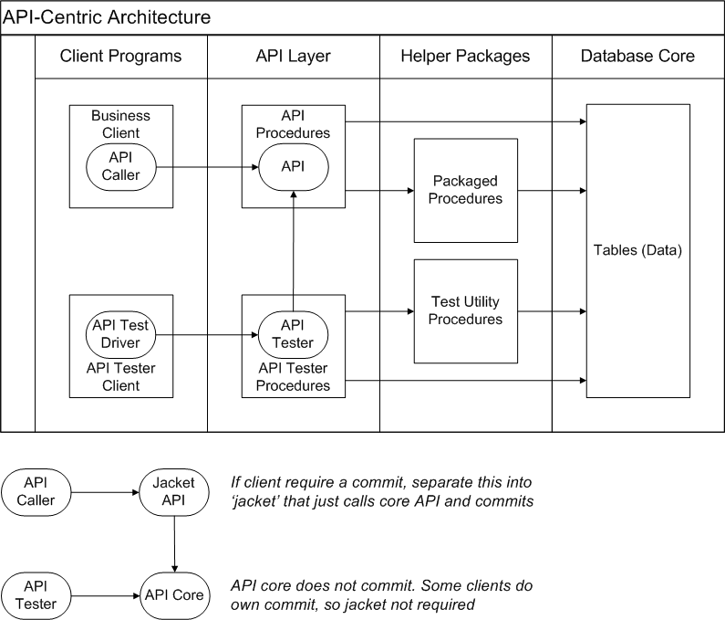
Thick Database Paradigm - Diagram

Slide 7
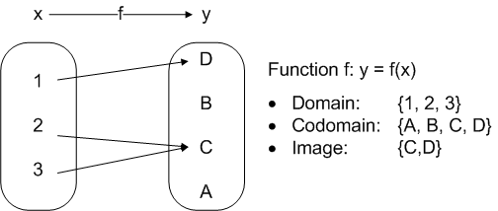
Mathematical Function
Function (mathematics) - Wikipedia
x and y can be simple points, as shown here, or complex objects
"In mathematics, a function is a relation between a set of inputs and a set of permissible outputs with the property that each input is related to exactly one output"
Notes:
Diagram based on one in the Wikipedia link, https://en.wikipedia.org/wiki/Function_(mathematics)

Slide 8
Functional Programming – Pure Functions
Functional Programming: Pure Functions
“A pure function is a function where the return value is only determined by its input values, without observable side effects. This is how functions in math work: Math.cos(x) will, for the same value of x, always return the same result. Computing it does not change x. It does not write to log files, do network requests, ask for user input, or change program state.” - Arne Brasseur
Testing a Function
Given a list of test inputs, X and a list of expected outputs, E, for function F:
For each x in X, with e in E:
Apply y = F(x)
Assert y = e
Advantages of Purity
Only need to check return value, y
No coupling between tests, can be run independently in any order
Expected return value, e, for given input, x, does not change over time, so repeatable
But Some Impurity is Necessary…
Notes:
https://www.sitepoint.com/functional-programming-pure-functions/

Slide 9
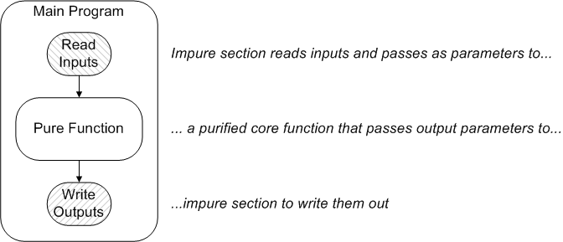
Functional Programming – Managing Impurity
Refactoring to Functional
“Our programs are processes that deal with inputs and generate outputs over time, they are not mathematical functions. There are ways to get the best of both worlds, however.
One fruitful approach is to separate the pure, functional, value based core of your application from an outer, imperative shell.” - Arne Brasseur
Notes:
https://www.sitepoint.com/functional-programming-pure-functions/

Slide 10

Database APIs and Impurity
Problems of Impurity for Testing
Inputs and outputs in tables and files, as well as parameters
Harder to access
One test writing to database may affect another
Coupling increases complexity
Nondeterministic outputs from sequences and datetimes
Automation hard as expected values not knowable in advance
Test results affected by other activity, as database is a shared resource
Automation hard as expected values change over time
Problem of Impurity for a Chef
John Cleese in “The Dirty Fork” sketch
Database testing occurs in a noisy environment, how to manage this…
Notes:
Image from http://www.intriguing.com/mp/completelydiff.php

Slide 11
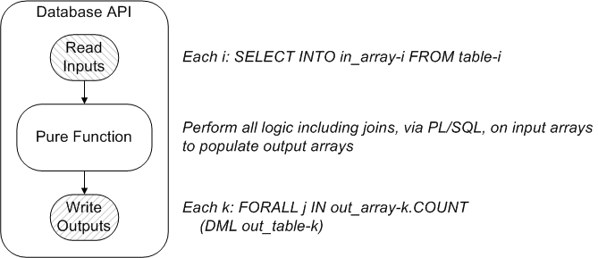
Database APIs – Manage Impurity by FP-Style Refactoring?
What Could Possibly Go Wrong?
The pure function now becomes easier to test, and the input/output parts are small, but…
SQL is a 4’th generation language (4GL), and its power is lost when core logic is transferred to a 3GL layer, leading to:
High complexity in the pure function
Unscalability as set-based SQL gives way to array processing

Slide 12


Noise Cancellation
Noise Problem
Developers in a European open–plan office trying to code…
…surrounded by noisy Business Analysts and Project Managers
Solution
Wrap our ears in Noise-Cancelling headphones
Can we similarly cancel out the database noise when testing APIs?…
Notes:
Bose headphones: https://www.bose.ie/en_ie/index.html
Office headphones: https://qz.com/185337/the-complete-guide-to-listening-to-music-at-work/

Slide 13
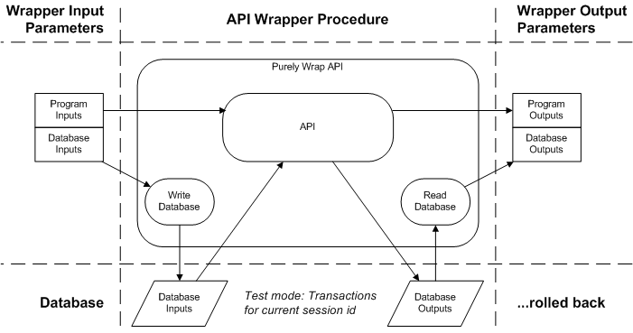
Database APIs – Manage Impurity by a Pure Wrapper
Wrap API in a ‘pure’ function with ‘extended signature’ and test that instead…

Slide 14
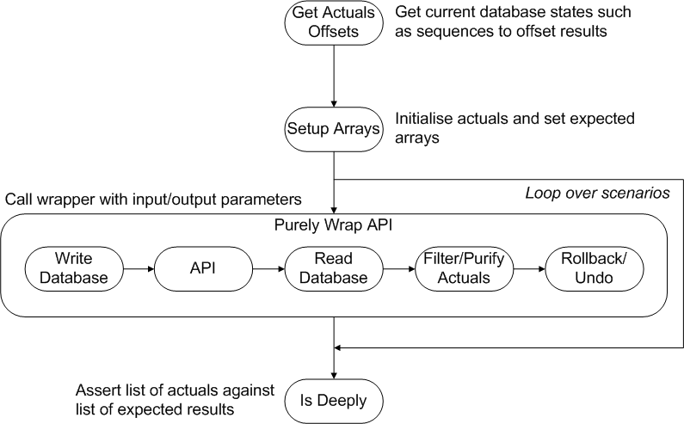
Test Procedure Using Pure Wrapper

Slide 15
Purifying the Actuals
Non-deterministic Values
Values such as sequence-set UIDs and SYSDATE fields non-deterministic
Offsets from current database state and date deterministic, so apply offsets to the actuals to purify the wrapper outputs (or, equivalently, to expected values in reverse)
Time components may still be uncertain, but can convert these to ranges, eg an expected update time can be assigned to a range of [test start time, test start time + 10 minutes]
In general we may apply functions to render non-deterministic values deterministic
Filtering Out Non-Test Records
Ideally, partition transactions by session id in a test mode as shown in next slide
If not possible, filter out the non-test records from others, eg by using marker strings in the test records created, then use only the test-generated records in passing the output actuals
Exceptions
Trap exceptions raised by API and convert to text
Rollback/Undo
Rolling back after computing actuals ensures next scenario is not coupled to the current, but…
Autonomous transactions may need to be reversed manually (eg as in DML error logging)

Slide 16
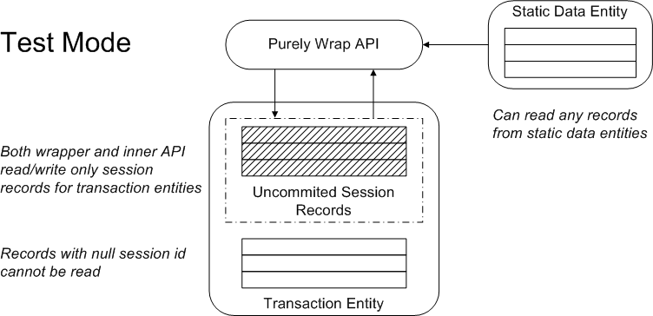
Test Mode Transaction Partitioning (if possible)
Partition transactions in test mode
Similar to eBusiness multi-org
Tables have ttid column, access by view
DML sets ttid to session_id in test mode
CREATE OR REPLACE VIEW employees AS
SELECT employee_id, ..., ttid
FROM hr.employees
WHERE (ttid = SYS_Context ('userenv', 'sessionid') OR
Substr (Nvl (SYS_Context ('userenv', 'client_info’), 'XX'), 1, 2) != 'TT')

Slide 17
A General Data Model for Testing
A General Data Model for Testing
Explaining why a general model is appropriate, and detailing the model in logical terms and with physical array structures

Slide 18
A General Data Model for Testing
Database APIs reference domain-specific data model, eg Oracle’s demo HR schema
Data models include normalized entities, reducing redundancy and simplifying programming
Referential and other constraints support database integrity
There is a natural data model for the testing of database APIs, for any domain
Note that inputs and outputs to the wrapper API can be regarded as ‘just’ strings, or collections of strings
A SOAP envelope wraps inputs and outputs for a web service procedure in a generic XML hierarchy (and JSON wraps REST service I/O)
Similarly, we can use generic data structures for our wrapper I/O
All that’s required outside the wrapper is to assert actual outputs against expected, and display results in a nice format
This can be achieved by a single call to a library utility, Is_Deeply, that takes generic PL/SQL collections as parameters
This leads to a generic model for input and actual/expected output data…

Slide 19
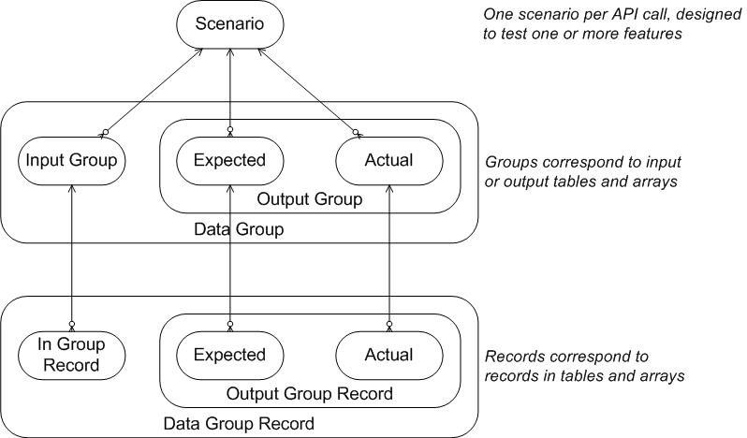
A General Data Model for Testing: Data Groups

Slide 20
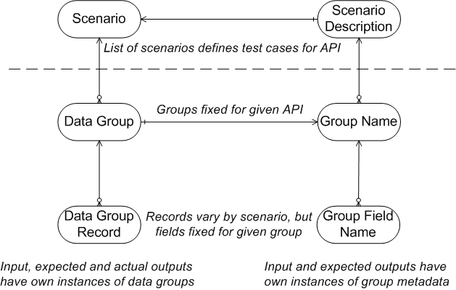
A General Data Model for Testing: Group Metadata
To display the results in a nice format within a general model, we can define some metadata

Slide 21
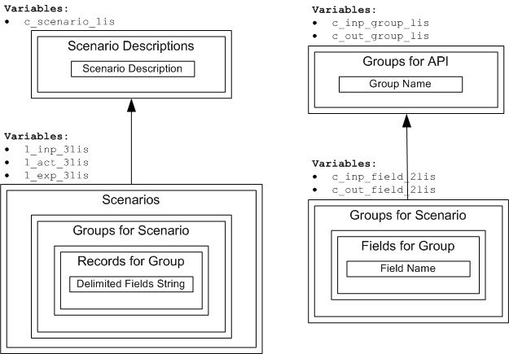
A General Data Model for Testing: Arrays
Only 1 group level is required in general, flattening where needed
See slide 34, ‘Complex Objects and Arrays’, for details

Slide 22
GDM Output and Code Examples
GDM Output and Code Examples
Extracted from my Github project, trapit_oracle_tester, showing how test inputs and outputs can be displayed using the data model, giving some PL/SQL code examples, and some notes on frameworks
Notes:
https://github.com/BrenPatF/trapit_oracle_tester

Slide 23
API Test Output Example – Showing Groups
SCENARIO 1: 1 valid record {
============================
INPUTS
======
GROUP Employee {
================
Name Email Job Salary
---- ----- ------- ------
LN 1 EM 1 IT_PROG 1000
}
=
OUTPUTS
=======
GROUP Employee: Actual = 1, Expected = 1 {
==========================================
F? Employee id Name Email Job Salary
-- ----------- ---- ----- ------- ------
358 LN 1 EM 1 IT_PROG 1000
} 0 failed, of 1: SUCCESS
=========================
GROUP Output array: Actual = 1, Expected = 1 {
==============================================
F? Employee id Description
-- ----------- -------------------------
358 THREE HUNDRED FIFTY-EIGHT
} 0 failed, of 1: SUCCESS
=========================
GROUP Exception: Actual = 0, Expected = 0: SUCCESS
==================================================
} 0 failed, of 3: SUCCESS
=========================
Example shows results for first scenario of testing a web service saving demo procedure
Scenario tests passing 1 valid record
1 input group, an array of employee records
3 output groups, with #records, #failed reported
Group: Employees table, with id, email etc.
Group: Output array parameter, with new UID and description
Group: Exception raised, if any, converted to text
# failures reported for scenario

Slide 24
API Test Code Extracts 1 – Array Types and Tester Main Block
Type Definition for 1-3 Level Arrays
CREATE TYPE L1_chr_arr IS VARRAY(32767) OF VARCHAR2(32767);
CREATE TYPE L2_chr_arr IS VARRAY(32767) OF L1_chr_arr;
CREATE TYPE L3_chr_arr IS VARRAY(32767) OF L2_chr_arr;
x_lis: array of type L1_chr_arr
x_2lis: array of type L2_chr_arr
x_3lis: array of type L3_chr_arr
Typical Test Program Main Block
BEGIN
Setup_Array;
FOR i IN 1..c_params_3lis.COUNT LOOP
Purely_Wrap_API (c_params_3lis(i), l_act_3lis(i));
END LOOP;
Utils_TT.Is_Deeply (c_proc_name, c_scenario_lis, l_inp_3lis, l_act_3lis, g_exp_3lis, l_timer_set,
c_ws_ms_limit, c_inp_group_lis, c_inp_field_2lis, c_out_group_lis, c_out_field_2lis);
EXCEPTION
WHEN OTHERS THEN
Utils.Write_Other_Error; RAISE;
END tt_AIP_Save_Emps;
All arrays passed to Is_Deeply are of one of the 3 types defined above
Purely_Wrap_API passes variables that are 1 element in a 3-level array, for 1 scenario
Within the procedure the parameters are defined as 2-level arrays
PROCEDURE Purely_Wrap_API (p_inp_2lis L2_chr_arr, -- input list of lists (record, field)
x_act_2lis OUT L2_chr_arr) IS -- output list of lists (group, record)

Slide 25
API Test Code Extracts 2 – Wrapper Main Block and Database Getter
Typical Main Block Structure for Pure Wapper
BEGIN
BEGIN
Do_Save (x_emp_out_lis => l_emp_out_lis);
Get_Tab_Lis (x_tab_lis => l_tab_lis);
Get_Arr_Lis (p_emp_out_lis => l_emp_out_lis, x_arr_lis => l_arr_lis);
EXCEPTION
WHEN OTHERS THEN
l_err_lis := L1_chr_arr (SQLERRM);
END;
x_act_2lis := L2_chr_arr (Utils_TT.List_or_Empty (l_tab_lis), Utils_TT.List_or_Empty (l_arr_lis),
Utils_TT.List_or_Empty (l_err_lis));
ROLLBACK;
Exceptions trapped and converted to text
Each group has array element in output 2lis, with empty arrays replaced by 1-record flag array
Typical Local Procedure to Get Database Record Actuals
PROCEDURE Get_Tab_Lis (x_tab_lis OUT L1_chr_arr) IS
BEGIN
SELECT Utils.List_Delim (employee_id, last_name, email, job_id, salary)
BULK COLLECT INTO x_tab_lis
FROM employees
ORDER BY employee_id;
EXCEPTION
WHEN NO_DATA_FOUND THEN NULL;
END Get_Tab_Lis;
Easy to collect delimited actual records array
Utility to delimit any number of fields
Bulk collect to output array
No data leaves array null

Slide 26

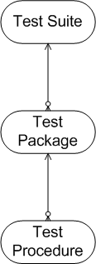
Testing Frameworks – What to Look For
No
What frameworks can do
Store procedures to be tested, and organize in packages and suites
Call the test procedures using dynamic SQL
Supply utility procedures to use in test code, such as assertions
Supply data structures to facilitate result gathering
Format test output results
What frameworks can’t do
Analysis of scenarios
Measure completeness of scenario coverage (to be discussed)
Write code for the database writing and reading of test records
What to look for in a testing framework
Alignment with conceptual framework around ‘pure’ wrapper function
Separation of assertion code from interior of wrapper function (only 1 assertion, or 1 per scenario at most)
Focus on features listed above with limited ‘bloat’
Notes:
https://weightwise.com/magic-bullet/

Slide 27
Test Coverage by Domain Partitioning
Test Coverage by Domain Partitioning
Explaining why code coverage is not a useful testing metric and developing, from examples, the concept of domain partitioning as a better approach for test analysis

Slide 28
Domain vs Code Coverage 1: Code Coverage
Why code coverage is not a reliable metric
Simple Java example of regex email address validation
Shows 100% code coverage for negligible scenario coverage
Base code: public bool ValidateEmail(string email)
return new RegEx("[a-zA-Z0-9_]+[@][a-z]+[.]com").matches(email);
Test code just tests 1 simple valid email address, but executes all (1 line) of base code
Test Code: void TestValidEmail()
Assert.IsTrue(EmailValidator.ValidateEmail("someone@email.com"));
Email address validation
A robust email validator, with a good data-driven approach to testing
“Packaged along with the free is_email() code is an XML file of 164 unit tests” – Dominic Sayers
SQL, a 4GL, can do many things in 1 statement, just like regex
Code coverage metrics tell you almost nothing about testing quality
Especially true for SQL and regex, but also true in general
Focus on code metrics likely to be worse than useless, as diverting resources from other areas
We want to assess domain coverage, not code coverage…
Notes:
https://dev.to/conectionist/why-code-coverage-is-not-a-reliable-metric-327l or (https://learningactors.com/why-code-coverage-is-not-a-reliable-metric/)
https://isemail.info/about

Slide 29
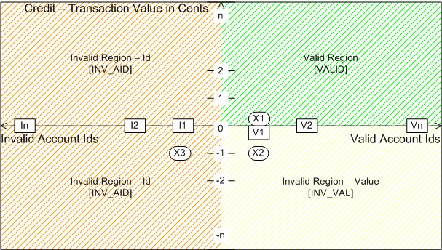
Domain vs Code Coverage 2: Domain Coverage Example
Consider bank transaction validation, inputs of account id, available credit and transaction value
Assume return value specifies Valid or Invalid with invalidity = Id or Value
Very large range of possible inputs, but consider the domain-partitioning scheme below
3 regions show same return value within, but different between, regions
In general, allow continuous variation within regions, eg return the resulting credit remaining
X | Tuple | Y
X1 | (V1, 0) | VALID
X2 | (V1, -1) | INV_VAL
X3 | (I1, -1) | INV_AID

Slide 30
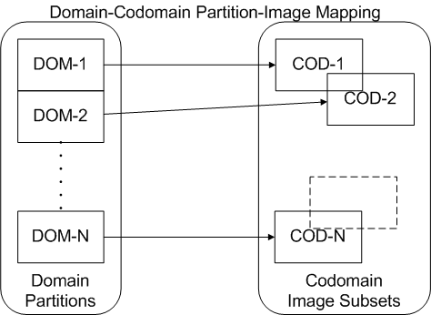
Domain Partitioning
Domain-Codomain Partition Pairs
In a mathematical function, a point X in the domain is mapped to a point Y in the codomain
Intuitively the differing behaviours of the API function can be considered to correspond to different pairs of domain/codomain regions within a domain partitioning scheme
Each domain partition maps to an image subset in codomain
But image subsets do not form partitions, as they may overlap

Slide 31
Subdomain Types and Coverage
Subdomain Types
In the bank transaction example there are two types of domain (or, actually, subdomain)
Range-Type: The amount field has behaviour defined by a numeric range, with a clear boundary (zero here) between partitions
2 test data points needed (just) on either side of the boundary to test both the different behaviours and the location of the boundary
Set-Type:The account id field has behaviour defined by whether the value is in a set or not
2 test data points needed: 1 in the set, and 1 not in the set (or, #sets + 1 in general)
Subdomain Coverage
If we identify p partitions in a subdomain, and have test data points in t partitions, following the rules above, then we have:
Subdomain Coverage Factor (SCF) = t/p x 100%
If we have d data points covering the p partitions then we can say:
Subdomain Coverage Efficiency (SCE) = p/d x 100%
For multiple subdomains, we need to account for the degree of coupling between them
In bank example, we had a subdomain of each type, but 3, not 4 (2x2), global partitions
To see how to get global coverage figures, let’s first look at another example…

Slide 32
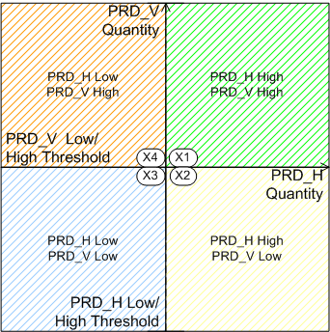
Subdomains and Decomposition
Graph: Pricing as Quantity Varies Across 2 Products
Independent Subdomains Example
2 product quantity fields with prices per item banded by quantity
2 output prices calculated independently for each field
Domain has 4 partitions (= 2x2)…
…but can test in parallel, with one call testing a partition in each subdomain, so (X1, X3) or (X2, X4) effectively achieve full domain coverage
Coupled Subdomains Example
Now consider the above example where 1 price per unit is determined by both quantities, applied to both items
Say 4 different prices according to band-pair
Now full coverage requires (X1, X2, X3, X4)

Slide 33



Global Domain Coverage
How many partitions in the overall domain?
Let there be S subdomains having partitions
Then for the global number of partitions, P, we have:
Domain Coverage
Independent Subdomains
If all subdomains are independent we can test them in parallel
This gives a total number of data points for full coverage as:
Fully Coupled Subdomains
If all subdomains are interdependent we must test all partition combinations
This gives a total number of data points for full coverage as:
Partially Coupled Subdomains
If some, but not all, subdomains are interdependent we must evaluate which partition combinations to test accordingly
This gives a total number of data points for full coverage between the upper / lower limits above

Slide 34
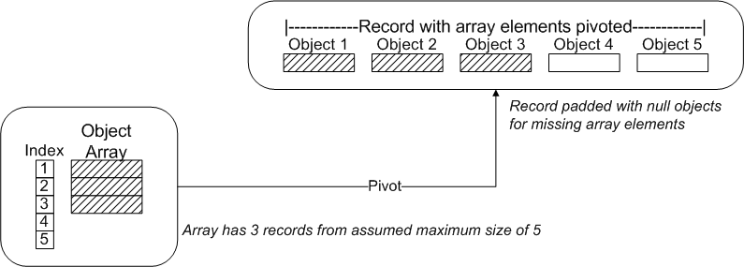
Complex Objects and Arrays
Complex Objects as Data Points
We think of mathematical functions as defined on a multi-dimensional space, of fixed dimension
APIs however may take complex objects that include multi-level arrays
We can map between the two conceptually in two steps (applied recursively):
Consider the arrays to be of fixed size (with null elements where necessary)
Flatten object array into fixed dimension tuple, with subdomains for each element
Testing input/output groups apply this physically to cover all data structures in one group level

Slide 35
Decomposition by Arrays
Map (higher-order function)
“In many programming languages, map is the name of a higher-order function that applies a given function to each element of a list, returning a list of results in the same order.”
Haskell Map Example:
> square x = x * x
> map square [1, 2, 3, 4, 5]
[1, 4, 9, 16, 25]
Arrays are often a special case of independent subdomains
For example, a batch load program may read independent records from a file
In testing, the wrapper API should take an array of input records and write them to the file
In such cases a single data point can test all subdomain partitions at once…
…except for any global conditions, such as validation count limits
Notes:
https://en.wikipedia.org/wiki/Map_(higher-order_function)

Slide 36
Testing Strategies
Testing Strategies
Discussing testing strategies, including the limits of testing, why/when/what to automate, and the homeopathic unit testing antipattern

Slide 37
Testing Strategy
Suggested Testing Strategy
Start by analyzing the domain structure, considering:
Partitioning
Dependency issues
Test efficiency and redundancy
Follow Data Driven Testing design pattern (DDT) described earlier
Develop the wrapper API using a single data point…
…then further data points can be added without extra programming (except debugging)
Aim to maintain 100% efficiency with 1 data point per partition until 100% coverage achieved
May also be useful to preferentially test partitions according to importance or likelihood of error
Limits of Testing
Cannot prove correctness (nor can anything else)
‘Pure’ wrapper function allows testing of its outputs, but what if the API writes unexpected data?
Need to review code, not just requirements, as part of domain analysis

Slide 38
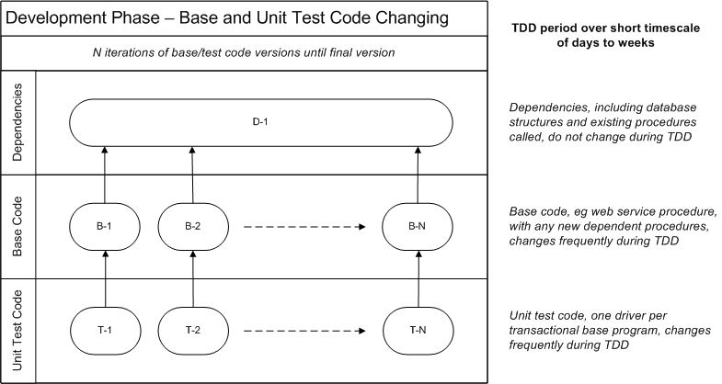
Phases of Testing 1: Development
In the development phase test code changes repeatedly with base code
At the end of development, base code may be safely re-factored using fixed test code
Dependencies do not change in general over relatively short timescale

Slide 39
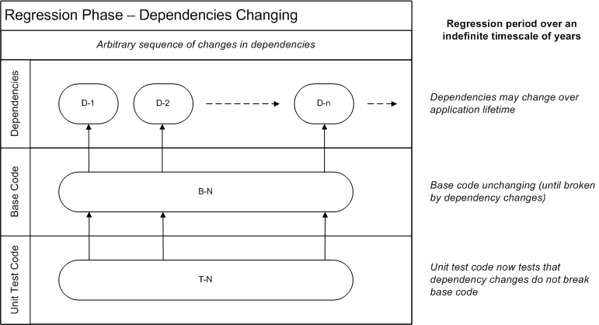
Phases of Testing 2: Regression
In the regression phase test code is executed repeatedly to check dependencies
Dependencies may change over relatively long timescale

Slide 40
Automated Testing: Why, When, What?
Why Automate?
In manual testing we often use whatever data are present at the time
Saves effort of creating test data, but…
…cannot automate as inputs, and hence outputs, not known to testing program
Automating takes significantly more effort to do initially, BUT negligible effort to repeat
When to Automate?
Whenever repeated testing is important…
Large projects with ongoing development over years
Agile methodology with frequent iterations adding functionality (CI/CD)
Ease of re-factoring desired
Otherwise manual testing is cheaper, and a valid option
What to Automate?
Only automate testing of the entry-point APIs, not lower level subprograms
Within testing of an API, can mix automated and manual
May be difficult to automate testing of some features, eg some exception handling cases

Slide 41
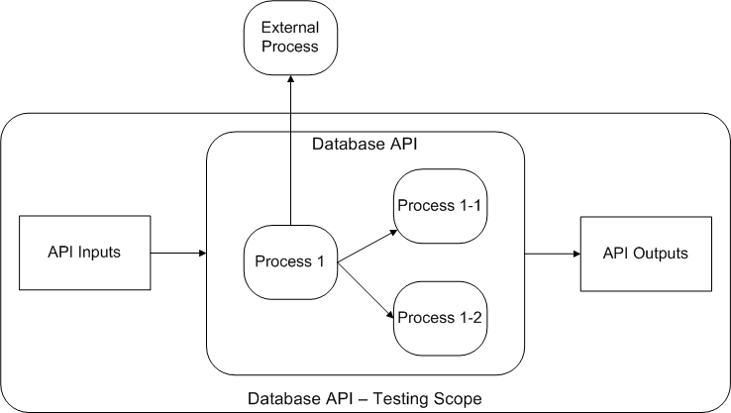
Test Only the Top-Level API, with Dependencies
Diagram represents testing API code as a whole, leaving dependency intact
This is the preferred pattern

Slide 42
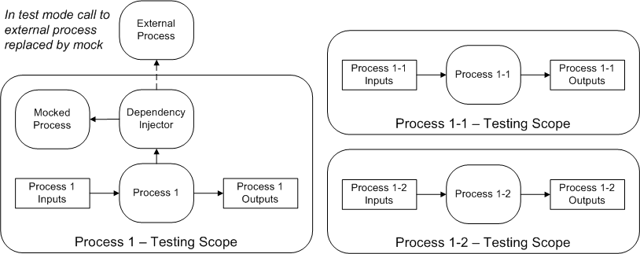
Avoid Dependency Injection and Low-Level Tests
Diagram represents mocking of dependency, and testing API code in small subprograms
This is an antipattern approach, to be avoided, causing…
Multiplication of test programs
Internal interactions become integrations, no longer in scope of unit testing
Refactoring of API no longer tested
Breaking dependency changes no longer captured in regression testing

Slide 43
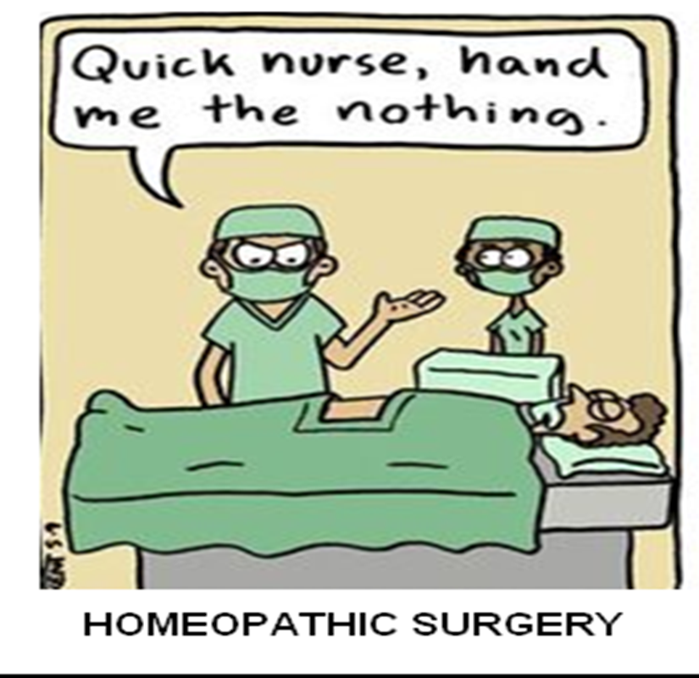
Homeopathic Unit Testing
3GL (eg Java) Unit Testing
Test complexity often regarded as a ‘code smell’
Aim to test code in small chunks and in isolation
Mock any dependencies
Database Testing
Database API in PL/SQL embedding SQL
Aim to do ‘heavy lifting’ in SQL, which is a 4GL
Breaking into small chunks the ‘code smell’ here
Want to test dependencies continue to be consistent in regression phase
Homeopathic Unit Testing
…testing small code sections without dependencies or significant structure
Regression tests are to test re-factoring and dependency changes
Notes:
https://www.pinterest.ie/pin/570479477772800215/

Slide 44
Conclusion
Conclusion
Highlighting the value gained from viewing database APIs and other code from the perspective of the mathematical function for both functional and performance testing

Slide 45
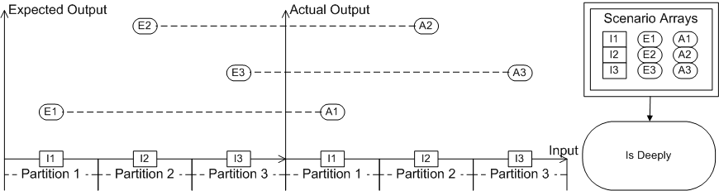
Value of the Mathematical Function in Functional Testing
Universal design pattern via ‘pure’ wrapper function around API
Provides standard template for programs
Resolves ‘brittleness’ caused by database impurity issues
Wrapper parameters may be seen as the ‘extended signature’ of the API
General 3-level data model for function inputs and outputs, expected and actual
Centralizes assertion in one library call, simplifying code
Data driven testing results in cleaner code and better testing
Test analysis and coverage benefit from domain partitioning approach

Slide 46
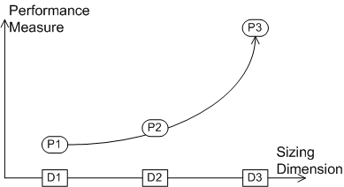
Value of the Mathematical Function in Performance Testing
Performance variation can often be expressed as a function of sizing dimension
Sampling across a range allows us to estimate the form of the function
Dimensional Performance Benchmarking of SQL - IOUG Presentation, 2017
Consider the resource usage of a query (or any code) to vary as a function of problem size
As with functional testing, set up and clear the test data programmatically
Call the function under test in a loop over a range of sizing dimension values
Sizing dimension can be anything that affects performance, such as number of records
Performance measure can be elapsed or CPU time, or any Oracle-instrumented measure
Gives useful information about comparative performance and scalability of different methods
Frameworks for automated testing, both functional and performance, available here:
Brendan’s GitHub Page
Notes:
http://aprogrammerwrites.eu/?p=2012
https://github.com/BrenPatF

Slide 47
References
A Programmer Writes… (Brendan's Blog)
Guarding your data behind a hard shell PL/SQL API, OOW 2017
Why use PL/SQL?, 2015
Function (mathematics) - Wikipedia
Functional Programming: Pure Functions
GitHub: trapit_oracle_tester
Why code coverage is not a reliable metric
Email address validation
Map (higher-order function)
Dimensional Performance Benchmarking of SQL - IOUG Presentation, 2017

